Slide 1
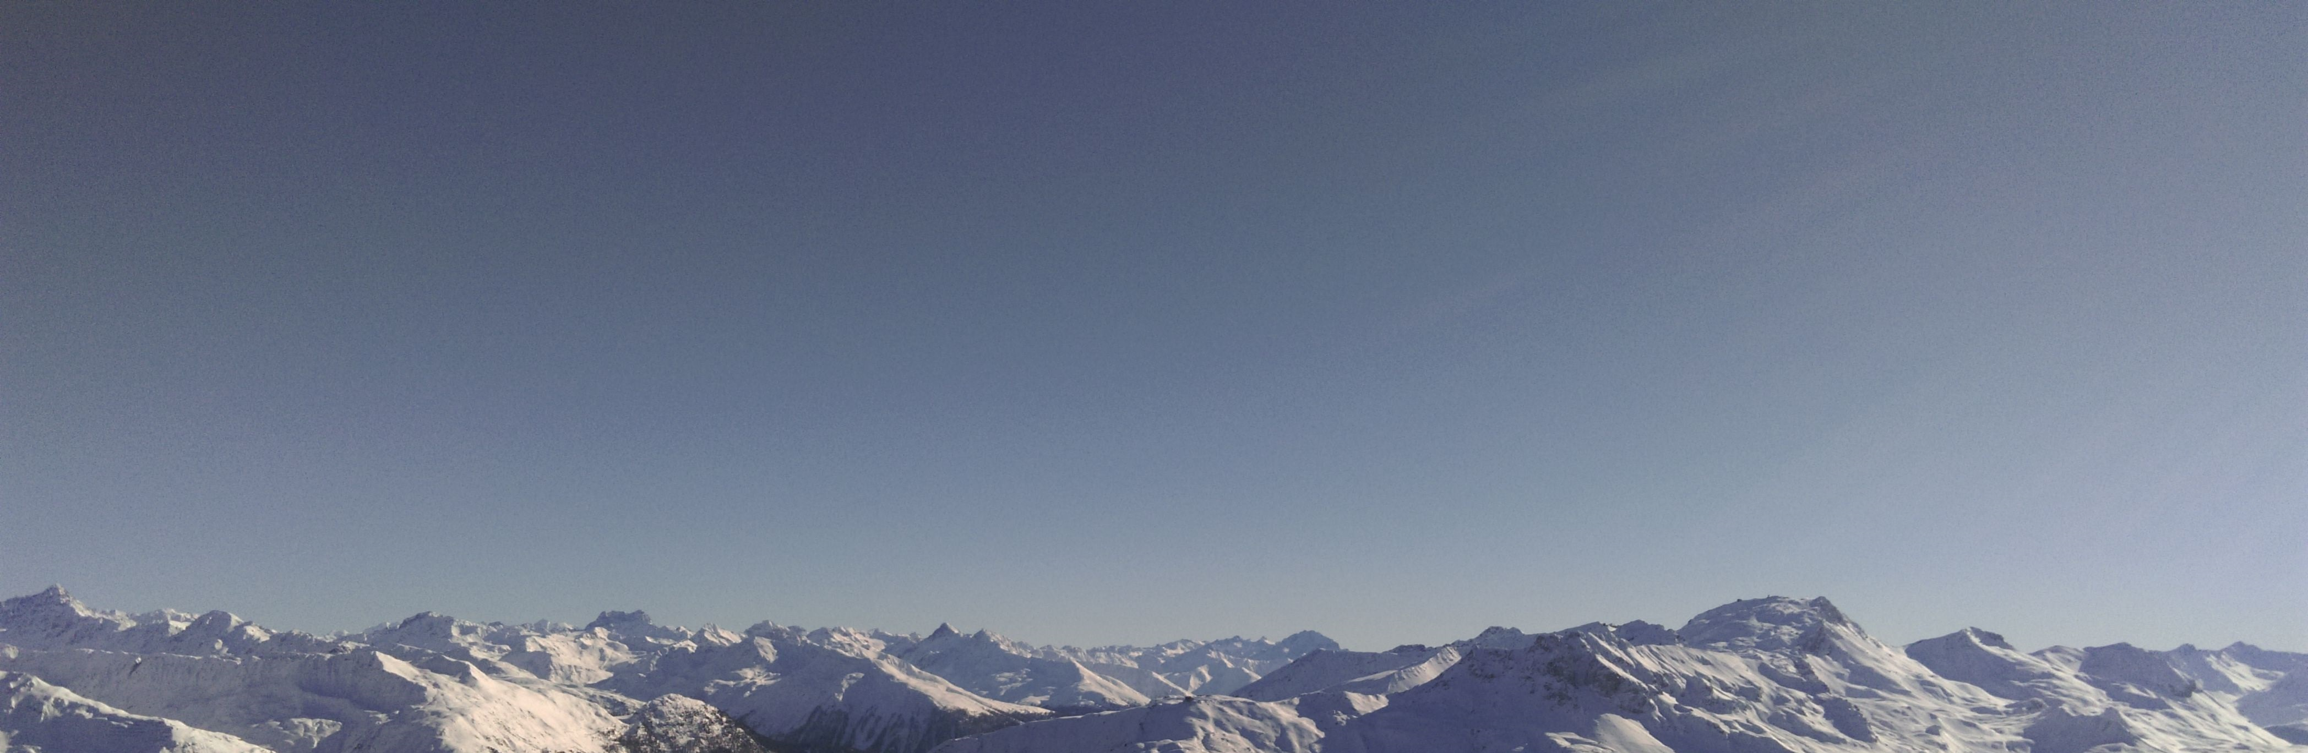
THE INTERNET OF FINANCE
KEYNOTE BY LUZIUS MEISSER
COMPUTER SCIENTIST AND ECONOMIST

Slide 2
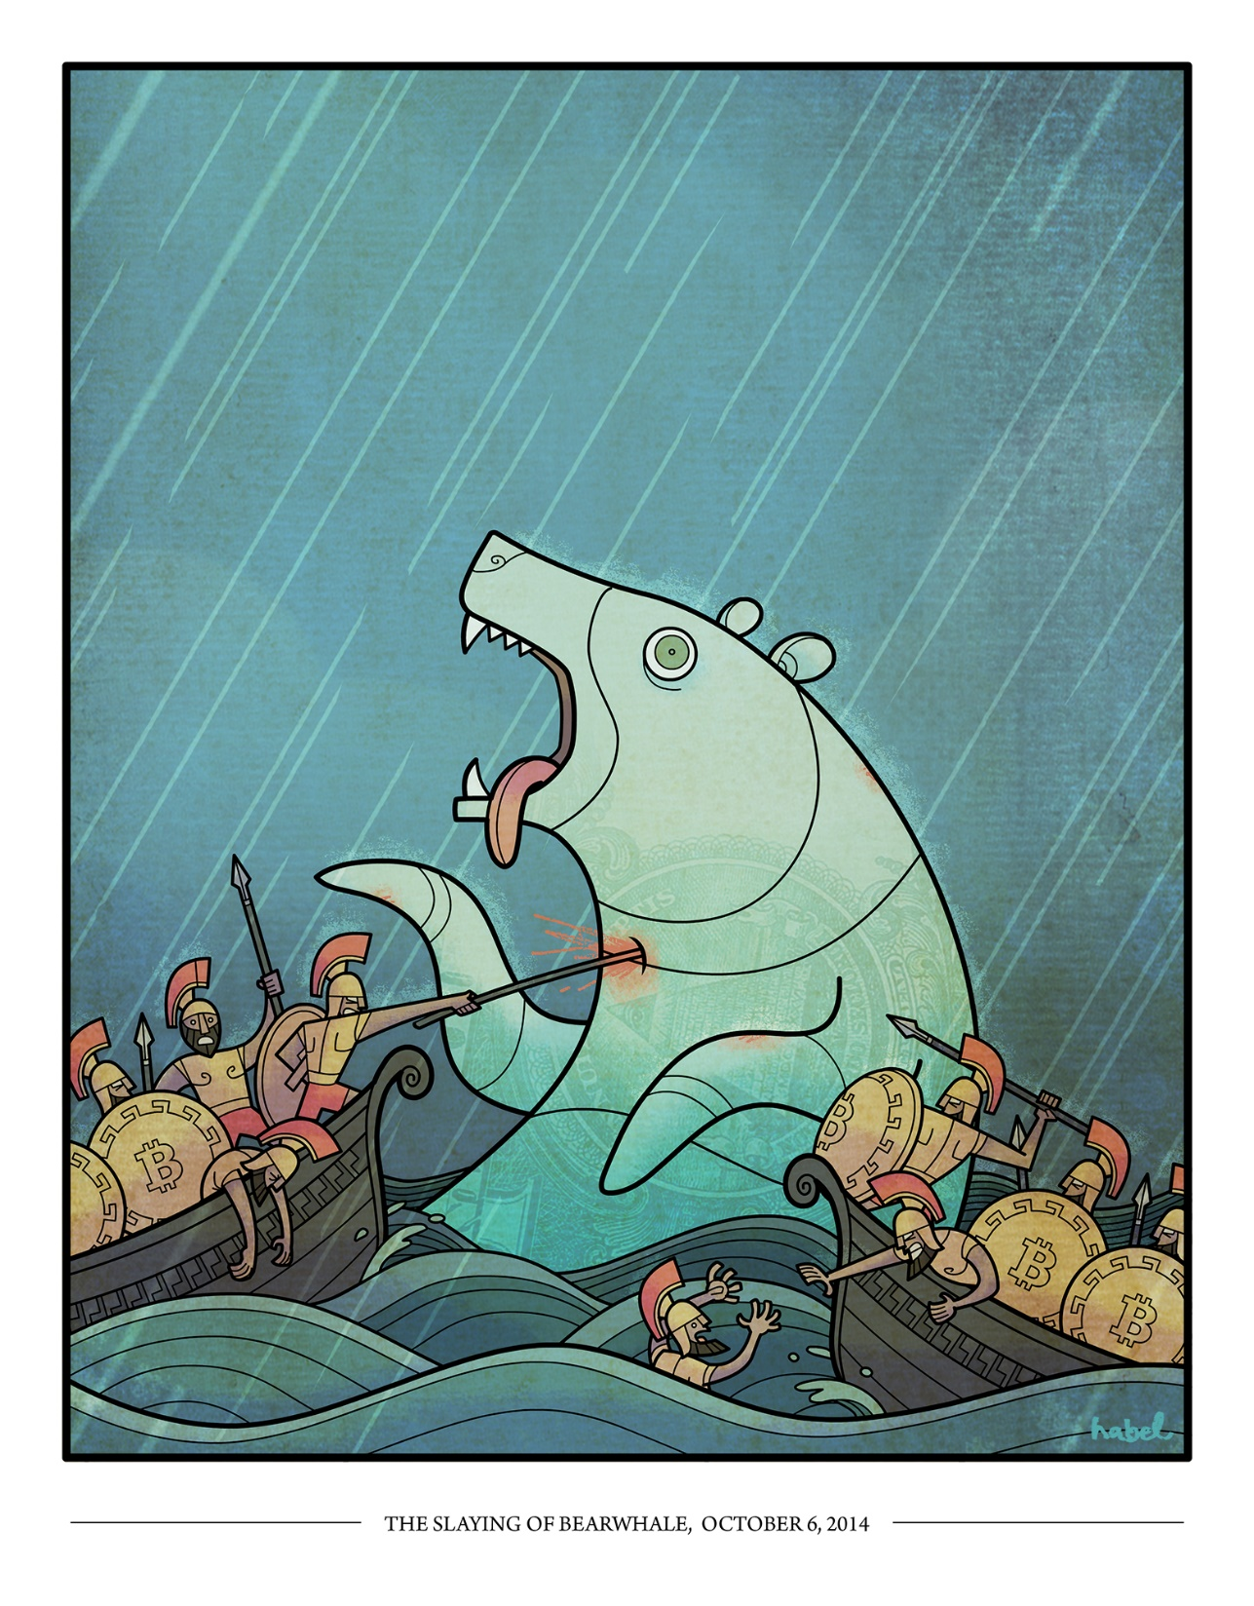
OVERVIEW
The economics of the digital age
Bitcoin: electronic cash
Ethereum: smart contracts
Killer use-case: ICOs
Investing in cryptocurrencies

Slide 3
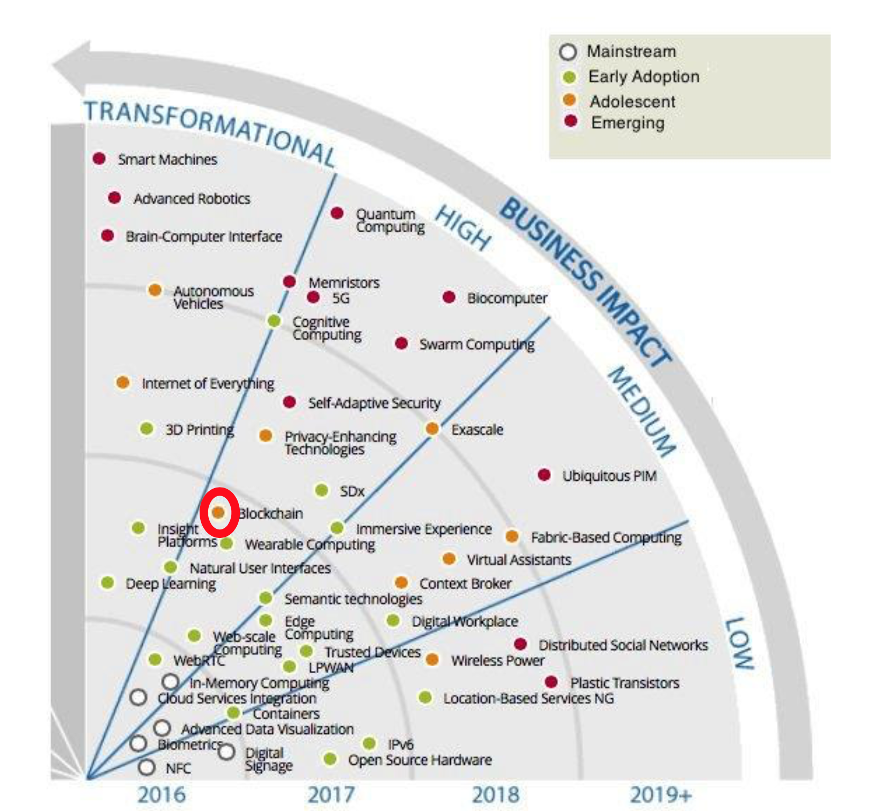
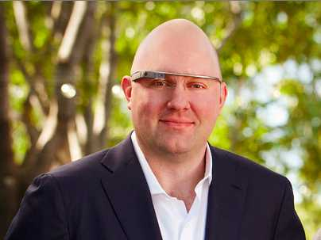
INNOVATION MAP
ascent.atos.net/look-out-2016/?wpdmdl=10428
«Software is eating the world.»
Marc Andreessen, Internetpionier und Investor

Slide 4
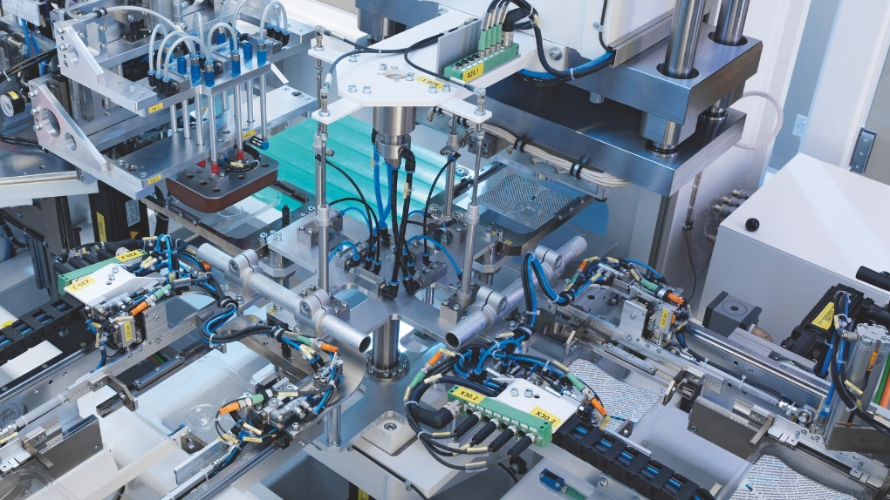
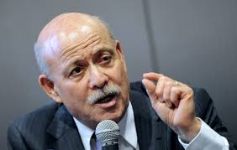
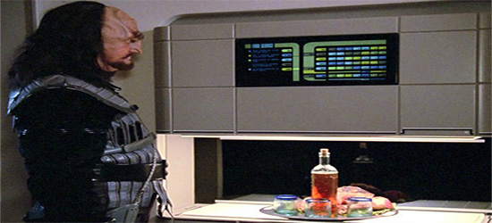
ZERO MARGINAL COST SOCIETY
The most expensive part in creating a software is the design stage. Production (copying it) is free.
Economist Jeremy Rifkin: Automation leads us towards a «zero marginal cost society», also for physical goods and services.
Transport: self-driving cars
Energy: Solar, wind
Production: 3D-Printing
Services: artificial intelligence
Finance: smart contracts
What would a world with food replicators look like?

Slide 5
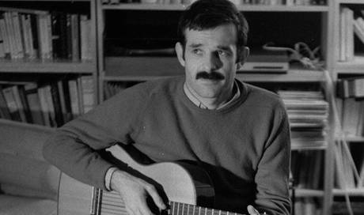
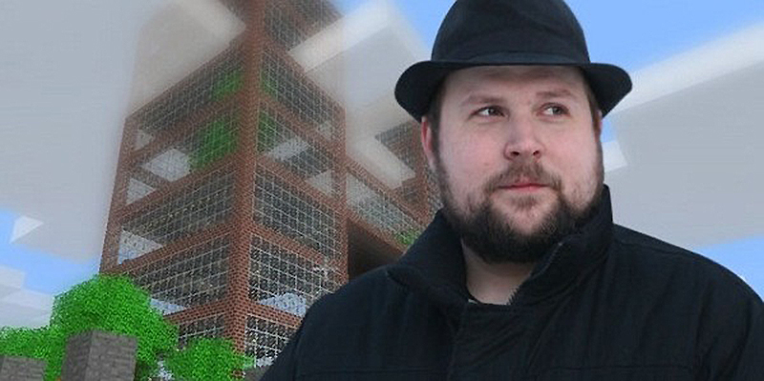
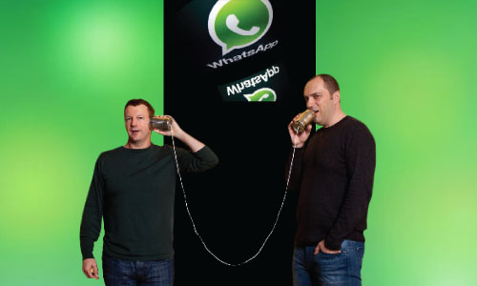
THE LAWS OF THE DIGITAL AGE
The winner takes it all! One search engine, one social network, one messenger, etc.
David beats Goliath! Small and agile beats large and centralized. Bottom-up beats top-down.
Clustering, just like in traditional industries. Film in Hollywood, Internet in Silicon Valley, pharma in Basel, etc.

Slide 6
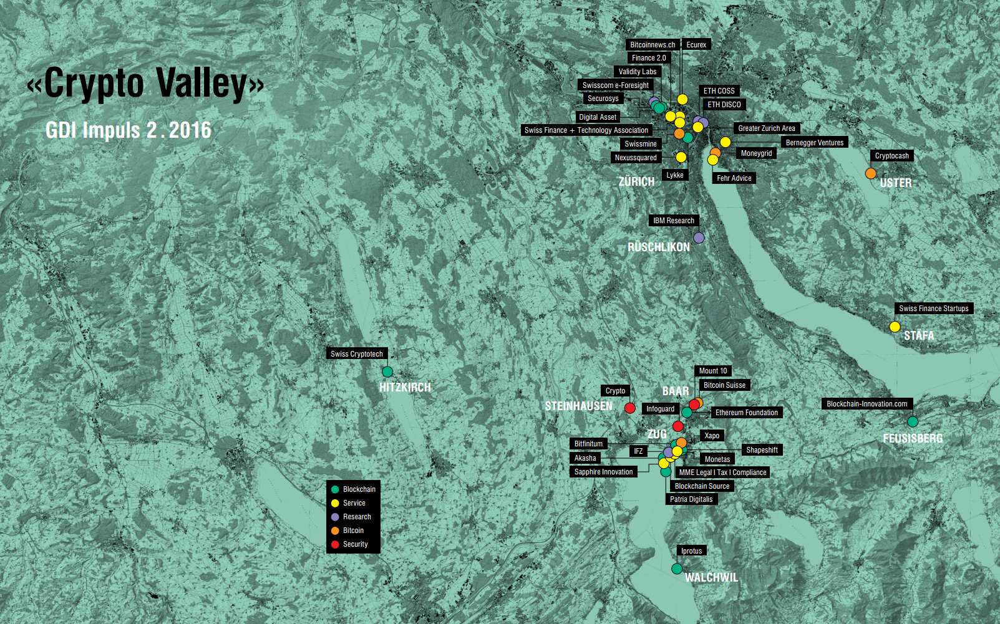
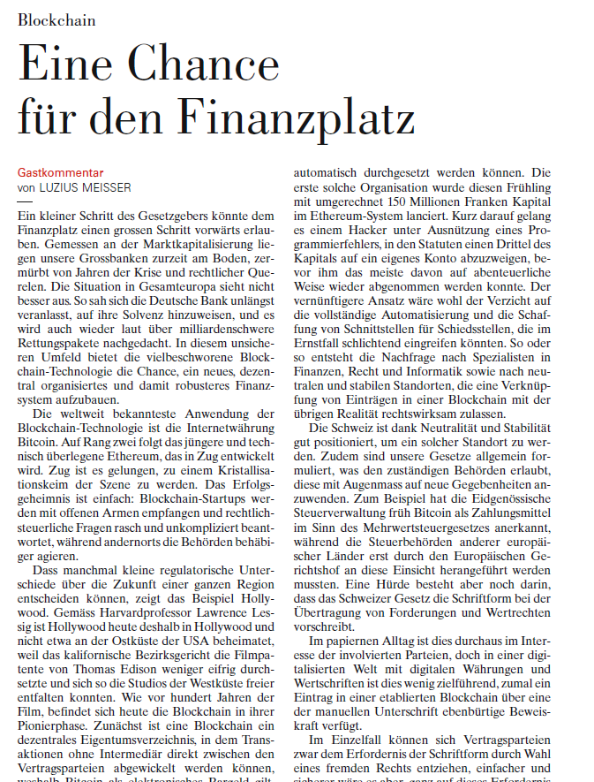

Slide 7
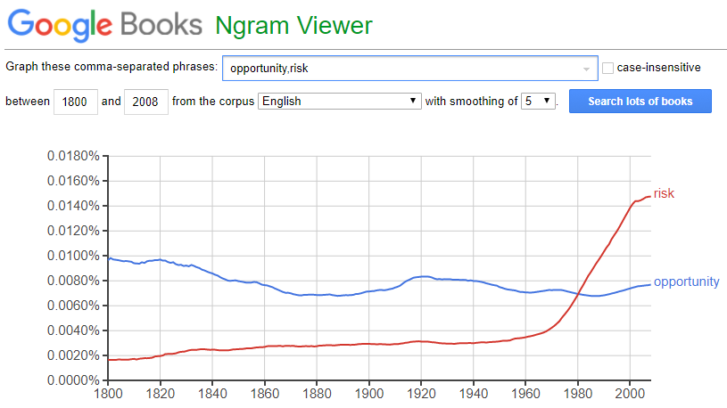
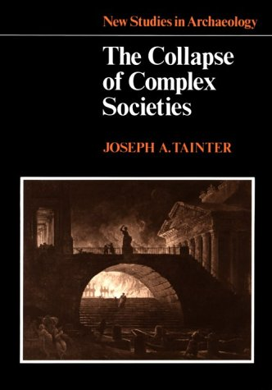
RISK: RISK-AVERSION
«Compliance is not a product.» - Daniel Aegerter, Fintech-Investor
«Die grösste Sorge bereitet mir, dass wir als Gesellschaft keine Risiken mehr eingehen. Darunter leidet unsere Wirtschaft und unsere Bildung. Angst tötet die besten Ideen.» - Patrick Aebischer, EPFL

Slide 8
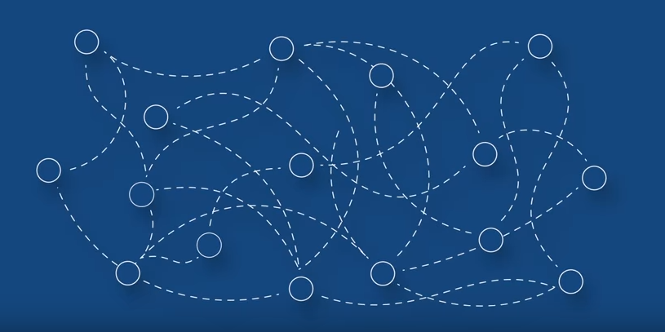
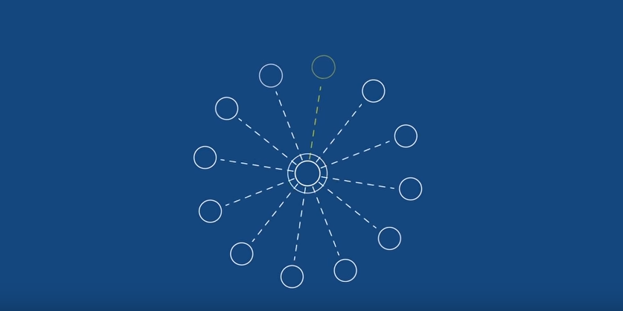
TODAY’S FINANCIAL SYSTEM (ACCORDING TO THE G20)
Before…
… and after the G20 added some regulation.
In their video “How is the financial system safer, simpler and fairer than before?”, the FSB (a G20 organization) claims to have made the global financial system safer, simpler and fairer by introducing more centralized control.
As a computer scientist, I see a big single point of failure!
(John Cochrane shares my opinion: http://johnhcochrane.blogspot.ch/2017/07/pollyanna.html )

Slide 9
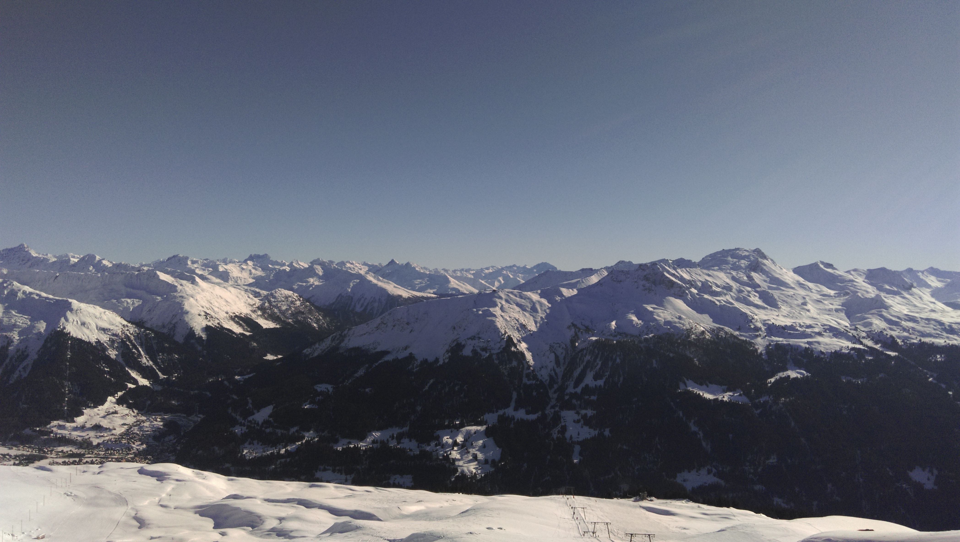
DYNAMIC EQUILIBRIA ARE MORE STABLE
The health of a forrest is determined by the young trees
Making old trees support each other makes the system as a whole more fragile
Tree line: small incremental differences in the surrounding conditions can have a huge impact

Slide 10
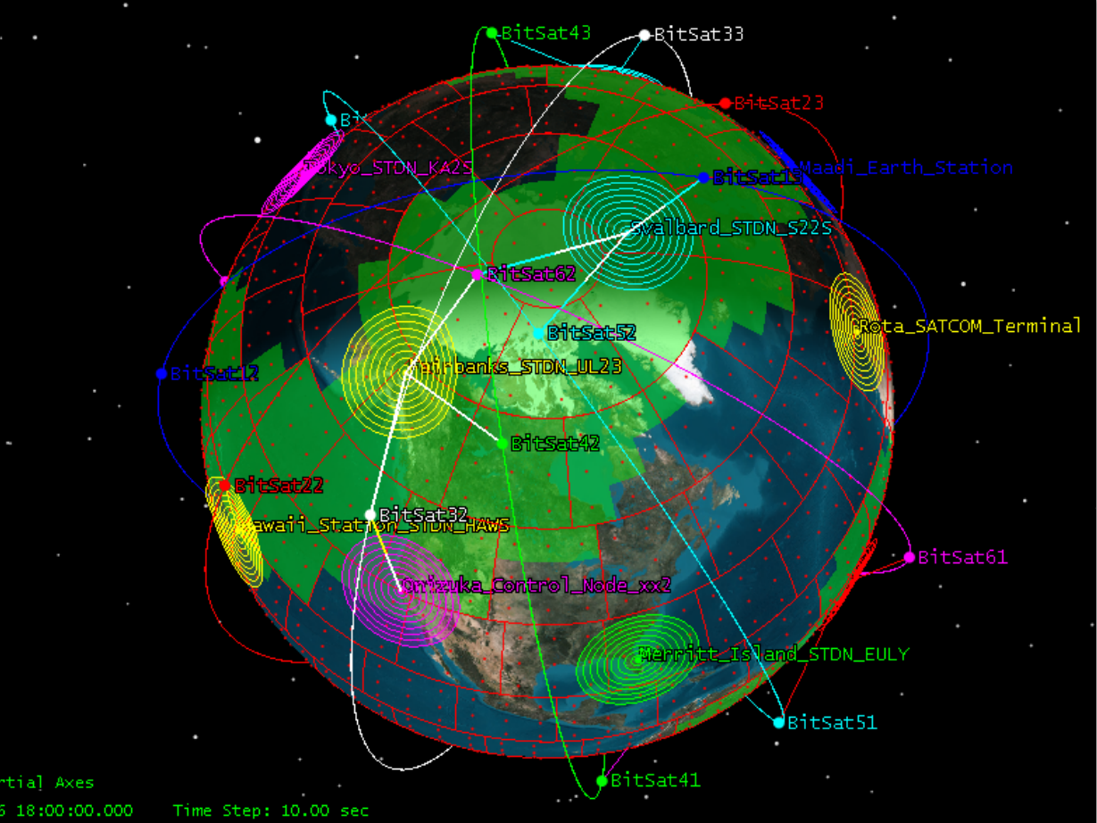
BITCOIN VISION
A decentralized, world-wide and free financial system.
An Internet of Finance.
Anyone can transact with anyone else at any time.

Slide 11
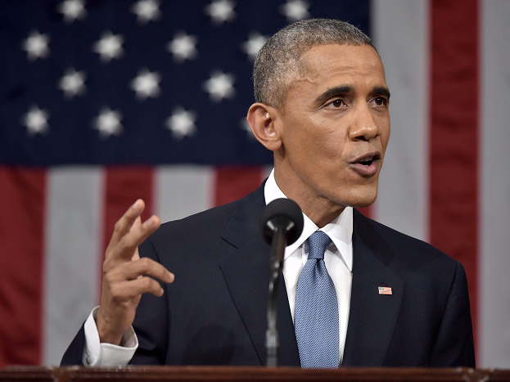
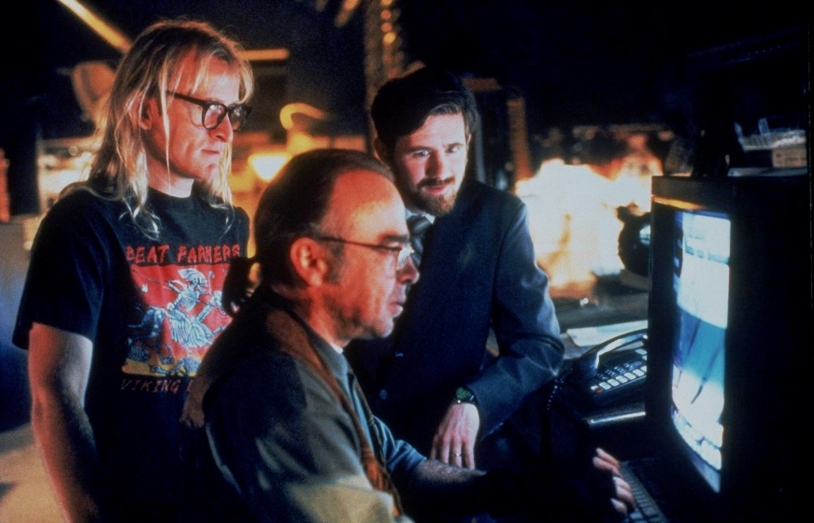
CYPHERPUNKS
Obama (former president of the US federal government) on encrypted phones: “If the government can't get in, then everybody is walking around with a Swiss Bank account in their pocket.”
Cypherpunks such as Satoshi Nakamoto or Julien Assange disagree. They distrust governments and corporations, want citizens to be responsible instead.
→ Book tip: The Souvereign Individual.

Slide 12
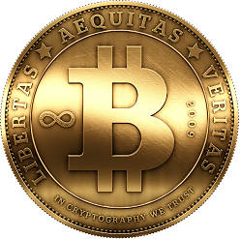
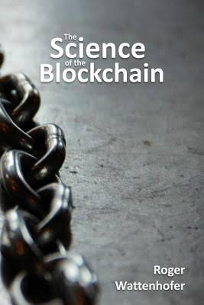
WHAT IS BITCOIN?
Bitcoin is digital cash.
Bitcoin enables the transfer of digital assets directly from person to person, without intermediary.
The underlying innovation is the blockchain, a very inefficient but also very robust way to reach distributed consensus.
I the blockchain unregulated? No, but traditional regulation that is attached to the financial intermediary does not apply, as there is none.
Notes:
5:30 (3 min)

Slide 13
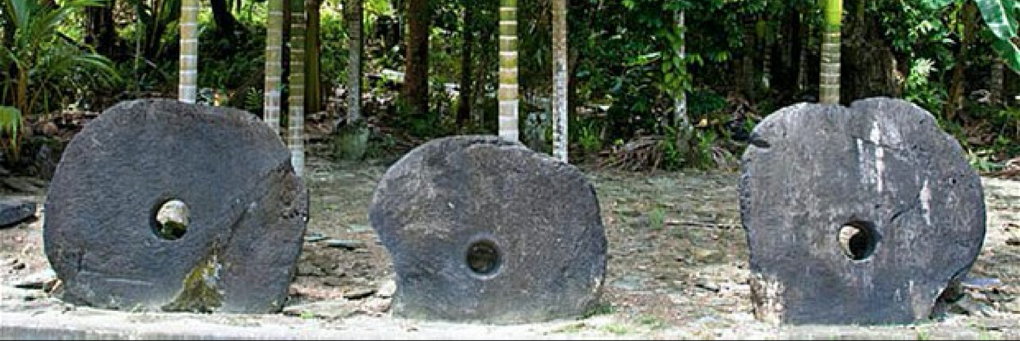
HOW DOES THE BLOCKCHAIN WORK?
Just like the stone money of Yap, but without the stones.
On the pacific Island Yap, stones act as money for large denominations.
Problem: the large stones are too heavy to carry around.
Solution: don’t carry the stone around, but tell everyone who it belongs to.
The blockchain works similarly: transactions become official by letting everyone know about them.

Slide 14
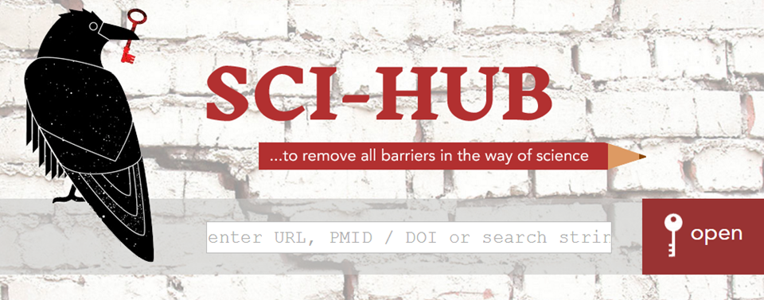
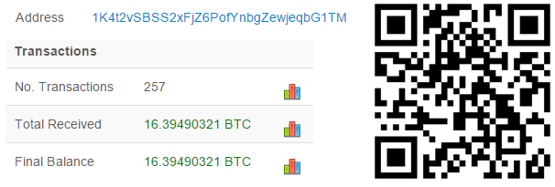
SCI-HUB

Slide 15
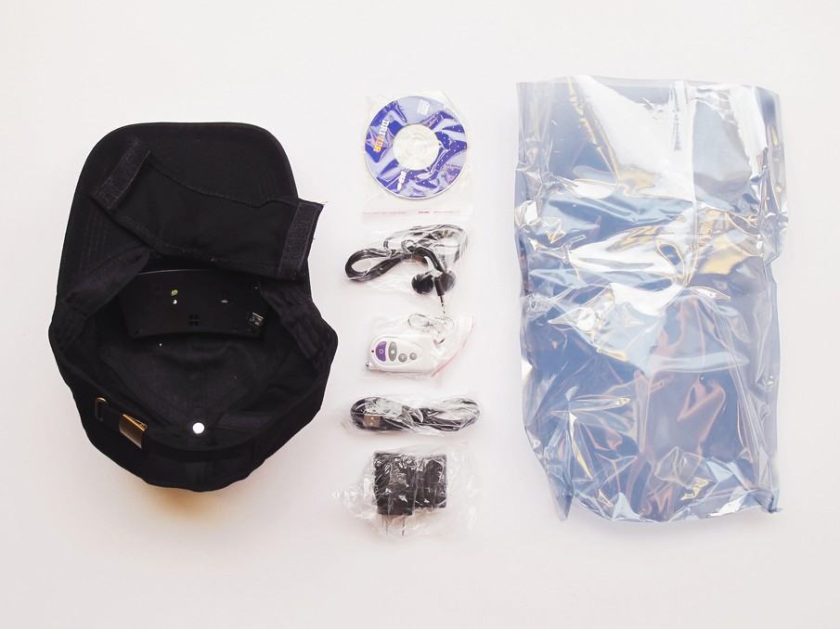
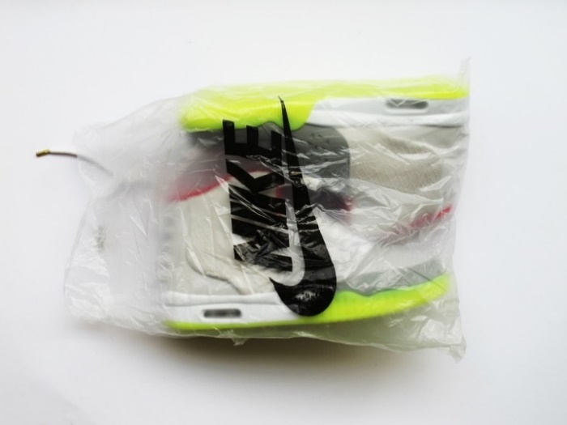
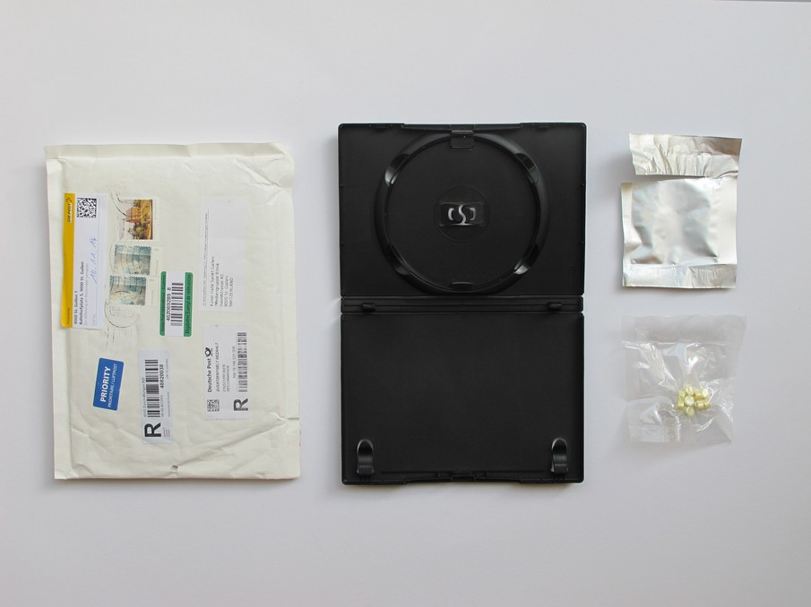
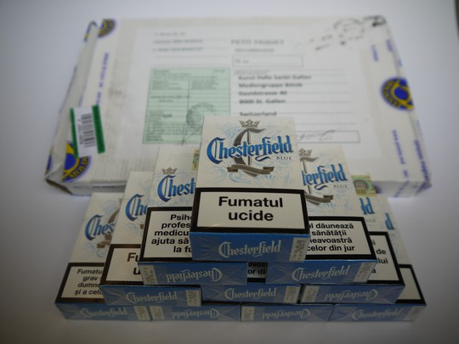
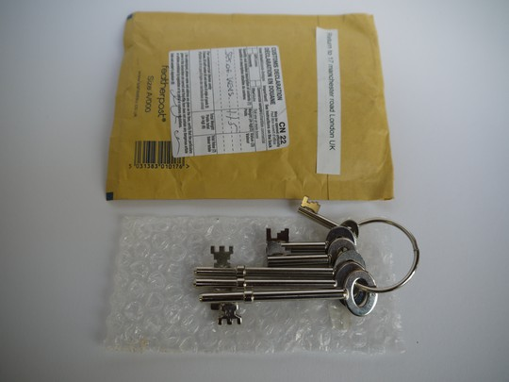
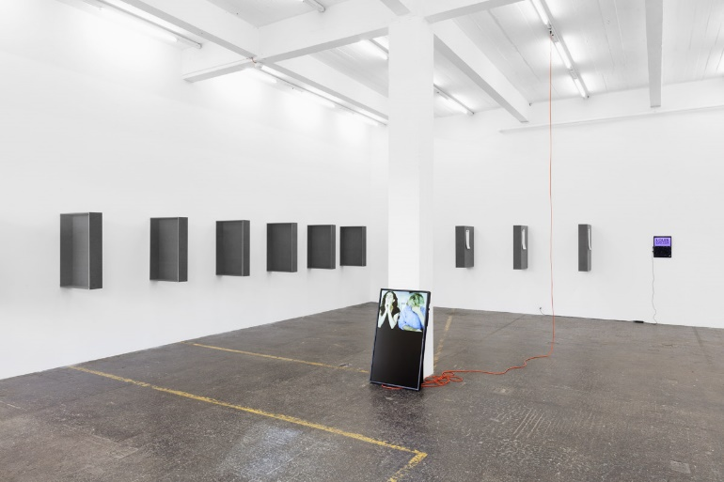
RANDOM DARKNET SHOPPER
Swiss art project by !MEDIENGRUPPE BITNIK
Computer orders random items from the dark net
All seized by Kantonspolizei St. Gallen, but get most things back as state attorney decided that the public interest and freedom of art prevails.
Now on tour all over the world.

Slide 16
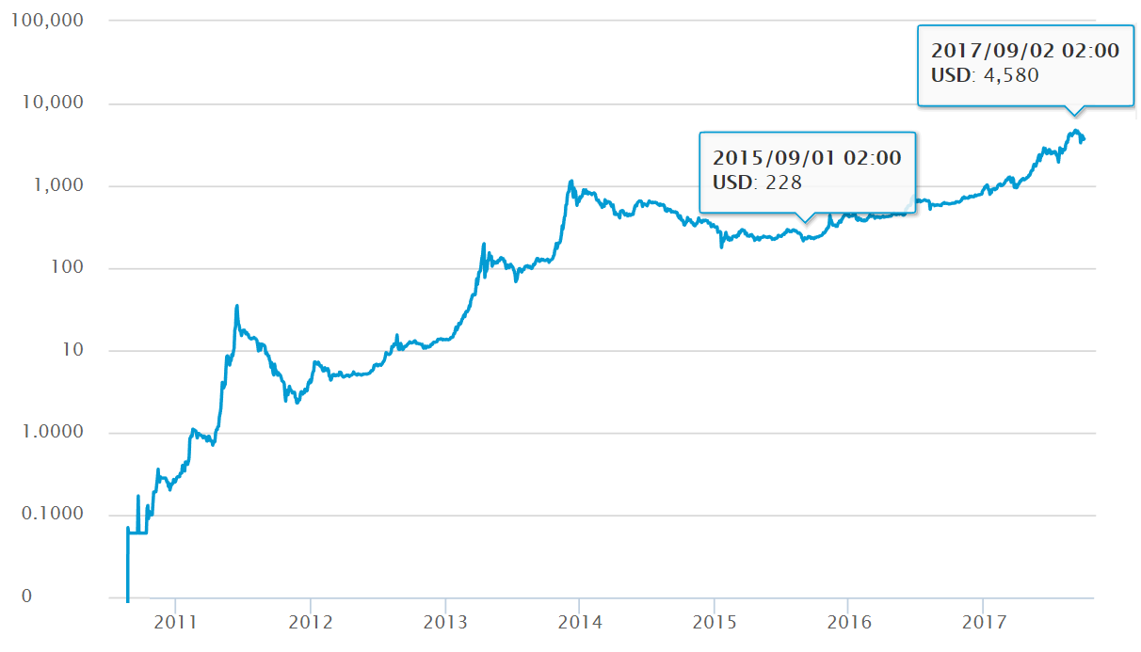

BITCOIN EXCHANGE RATE
Notes:
5:30 (3 min)

Slide 17
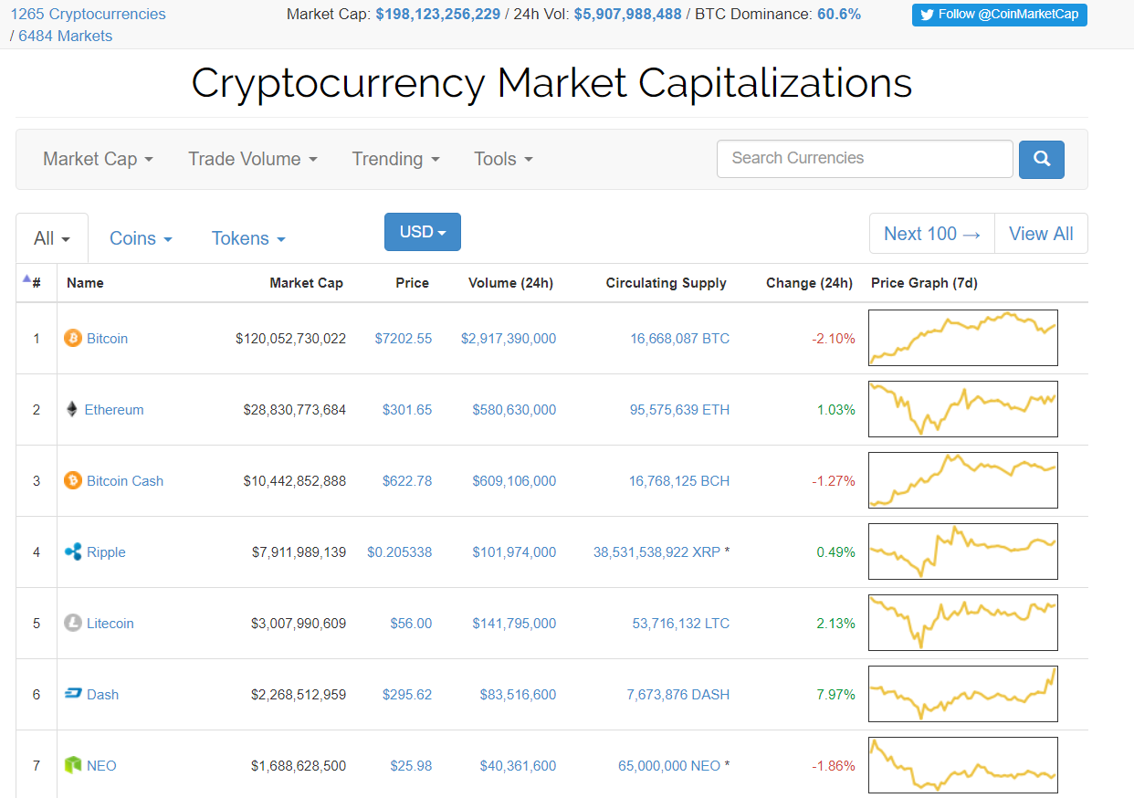
COINMARKETCAP.COM

Slide 18

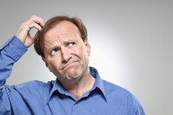
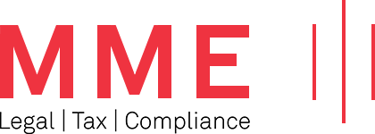
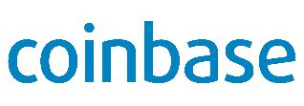
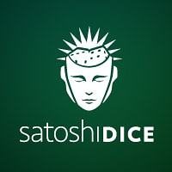
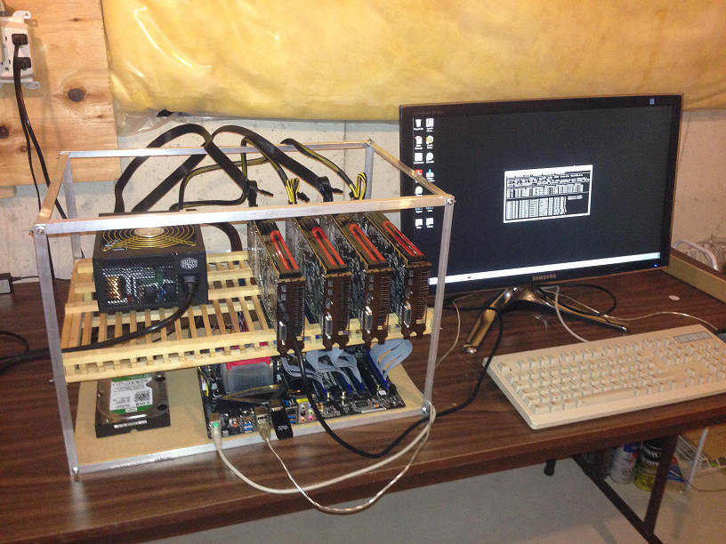
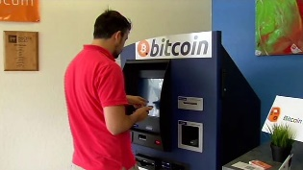
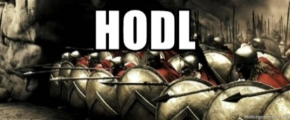

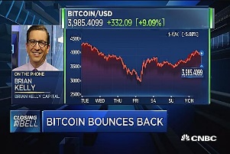
ECOSYSTEM
Lawyers
Crypto-Startups
Banks
Issue tokens to fund themselves
Merchants, Gambling, etc.
Exchanges,
Broker
Miner
“mine” new coins,
Operate infrastructure
Users
“Hodler”
Traders
Regulators
Long-term speculation,
Value preservation.

Slide 19
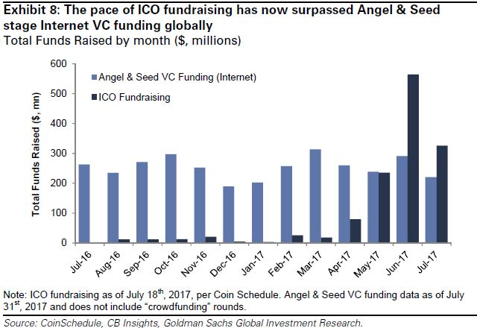
INITIAL COIN OFFERINGS
Currently, we are in a hype.
The few good ICOs are hopelessly overvalued.
Mid-term outlook: startups still do traditional seed funding, but turn to ICOs for the 3rd or 4th round of financing, once they have a useful product and reputable investors to back their claims.
CNBC: ICOs recently overtook venture capital for funding Internet startups.
https://www.cnbc.com/2017/08/09/initial-coin-offerings-surpass-early-stage-venture-capital-funding.html

Slide 20
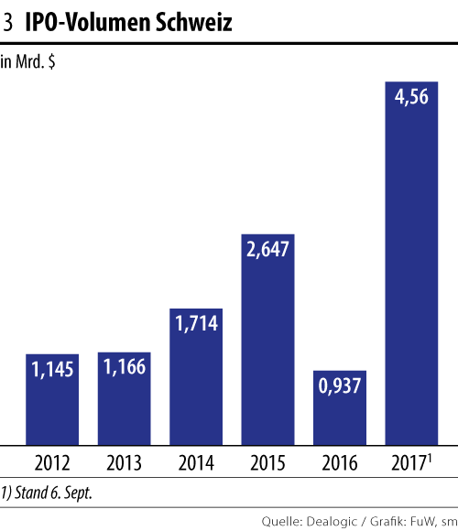
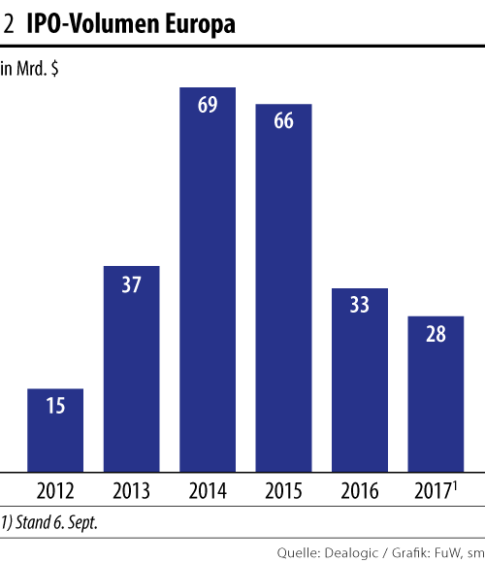
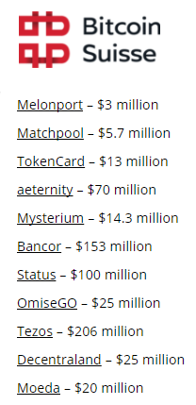
INITIAL COIN OFFERINGS
My bold claim: within five years, ICOs will overtake IPOs as a way to raise funds.
Bitcoin Suisse already served as a broker for ICOs that raised 635 Mio USD this year.

Slide 21
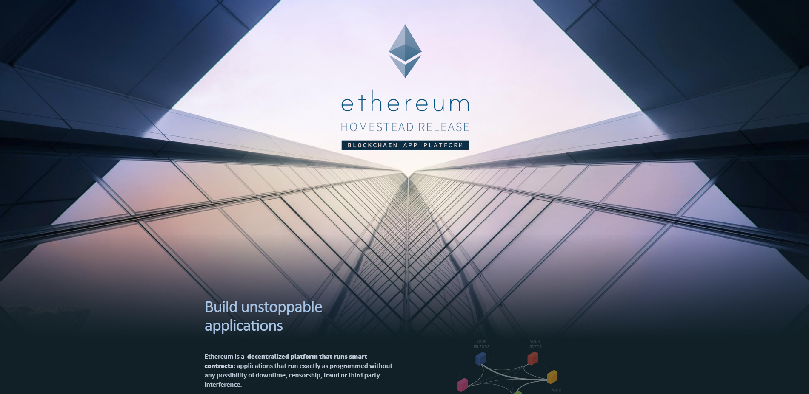
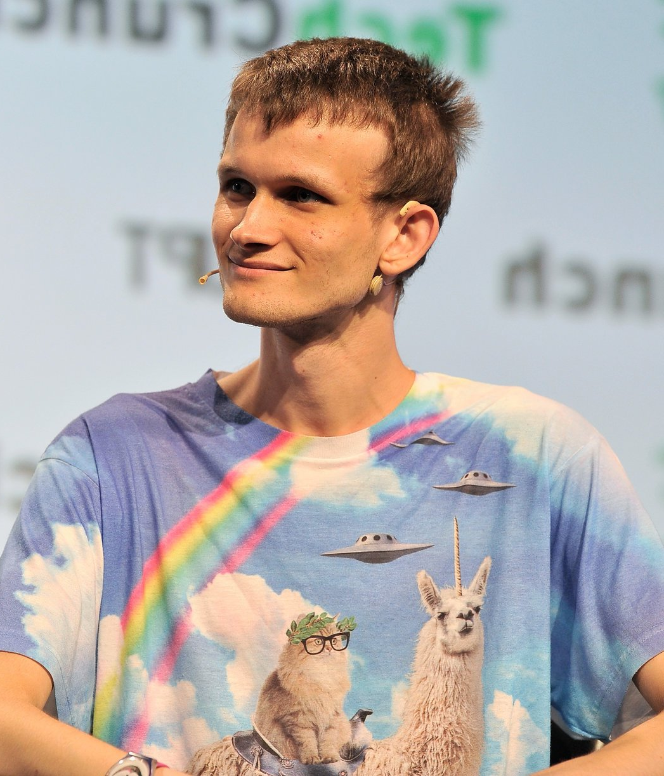

Slide 22
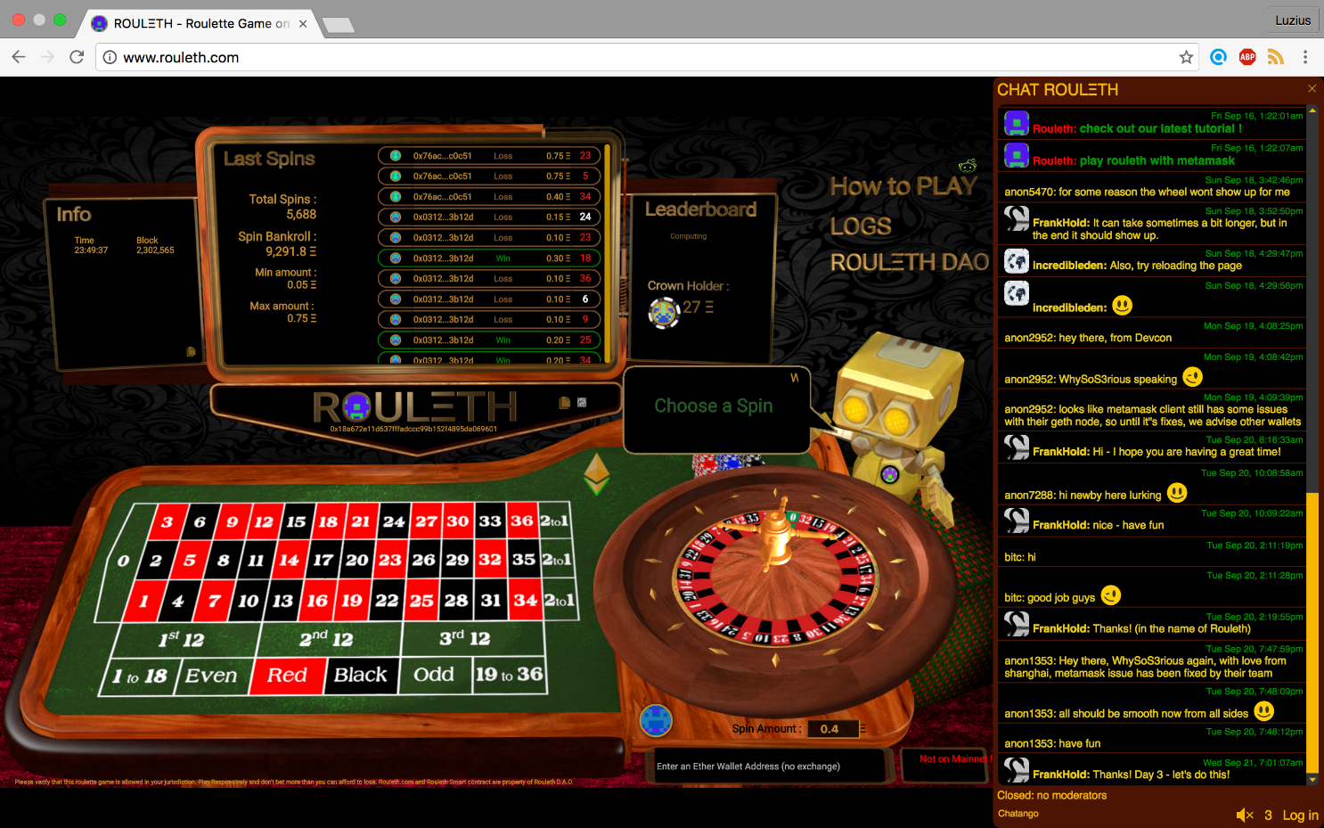
EXAMPLE: ROULETH
// ROULETH
//
// Play the Roulette on ethereum blockchain !
// (or become a member of Rouleth's Decentralized Organisation and contribute to the bankroll)
contract Rouleth
{
//Game and Global Variables, Structure of gambles
address developer;
Gamble[] gambles;
.....
//bet on Number
function betOnNumber(uint8 numberChosen) {
//check that number chosen is valid and record bet
if (numberChosen>36) throw;
placeBet(BetTypes.number, numberChosen);
}
}
.....
}

Slide 23
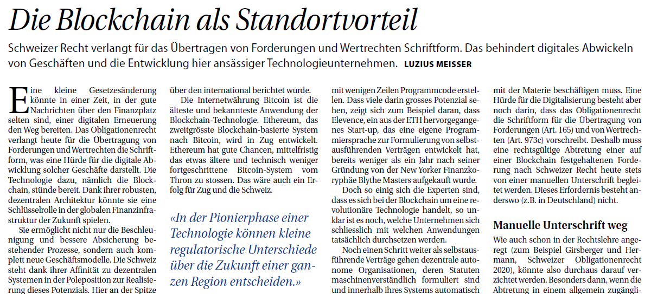
SELF-EXECUTING CONTRACTS
Execute automatically within their system
Can only refer to objects that are adequately represented in the system
Legally binding representation of securities on the blockchain would enable many innovations

Slide 24
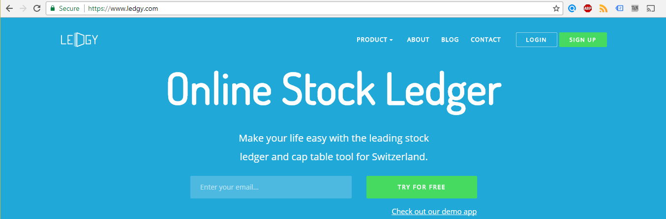
EXAMPLE: SHARES ON THE BLOCKCHAIN
Immediately tradable world-wide Cost of a world-wide IPO: millions, cost of an ICO: 10 CHF
Atomically exchangeable for other assets on the same blockchain
Continuous dividends
Provably correct votes
Self-enforcing shareholder agreements

Slide 25


BANCOR: THE VALUE OF LIQUIDITY
Some believe, ICOs are just a way to circumvent the overly regulated IPOs.
(This in itself already brings huge value. For example, there are only half as many listed stocks as 20 years ago, making the investable universe of your pension fund much smaller than it should be. All the additional regulation did not only protect average Joe from risks, but also from returns.)
But there is much more. For example, guaranteed liquidity!
As a rule of thumb, stocks that are illiquid trade at a discount of 25%. So providing liquidity can unlock enormous value. The Bancor protocol does exactly that.
The brillant idea: let a smart contract act as a market maker. Anyone can send money to that smart contract and get freshly printed shares in return. To sell them again, just send them to the smart contract, where they are destroyed again, and get some money back.
The price is always adjusted such that the reserves of the smart contract amount to 10% of the total market capitalization.

Slide 26

USE CASE: REFIND.COM
Excellent social news aggregator by Dominik Grolimund
Gives away 20 relevance coins to you and me if you sign up with this link: https://refind.com/Luzius?invite=EVYnDA8FMD (also on meissereconomics.com/about)
1 billion relevance coins are given away for free to reward active users
Once complete, the coins become freely tradable on the blockchain
Refind.com will spend 10% of its profits every year to buy back 99% of all coins
Last 1% will expire worthless
Refind has an option to buy back coins from anyone at 31 USD per coin
→ Escapes the Howie test.

Slide 27
INVESTMENT IDEAS
Disclaimer: these are just ideas. Apply your own judgement. ☺
While demand is unknown (market psychology), supply is usually predetermined.
Every four years, the rate of newly minted Bitcoins is cut in half, next time in 2020 from 1800 to 900 Bitcoins per day → With constant inflow, this should double the price
Ethereum is planning to switch from proof-of-work to proof-of-stake in late 2018 → removes implicit price ceiling completely. I am speculating on a big boost.
Many currencies have no intrinsic value, comparable to gold.
In the digital world, the winner takes it all. → Bet on the big names and not the small and unknown challengers.
The calendar trick to escape groupthink: if you feel like buying Bitcoin or Ether, don’t do it today, but mark a random date in your calendar a few months from now. This decouples your investment decision from the (potential) hype.

Slide 28
SUMMARY
The blockchain is an inefficient, but tamperproof decentralized database.
Primary use-case is a ledger to track ownership (only needs small amounts of data, but high security) of a currency or token with a «promise» behind.
Smart contracts enable the creation of arbitrary rules that refers to other smart contracts and tokens on the same blockchain.
ICOs are an interesting new funding instrument
Some country will become the “Luxembourg of ICOs”, currently most competitive: Switzerland, Singapore, UK
Events: bitcoinassociation.ch
Contact: luzius@meissereconomics.com

